Slide 1
Physics 111: Mechanics Lecture 6
Dahiru Sanni
Physics

Slide 2
Energy
Energy and Mechanical Energy
Work
Kinetic Energy
Work and Kinetic Energy
The Scalar Product of Two Vectors

Slide 3
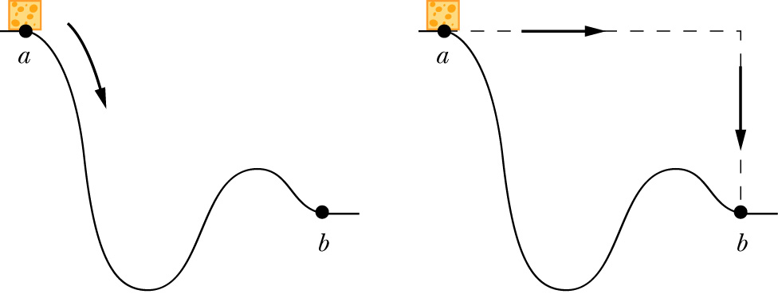
Why Energy?
Why do we need a concept of energy?
The energy approach to describing motion is particularly useful when Newton’s Laws are difficult or impossible to use
Energy is a scalar quantity. It does not have a direction associated with it

Slide 4
What is Energy?
Energy is a property of the state of a system, not a property of individual objects: we have to broaden our view.
Some forms of energy:
  Mechanical:
    Kinetic energy (associated with motion, within system)
    Potential energy (associated with position, within system)
  Chemical
  Electromagnetic
  Nuclear
Energy is conserved. It can be transferred from one object to another or change in form, but cannot be created or destroyed

Slide 5
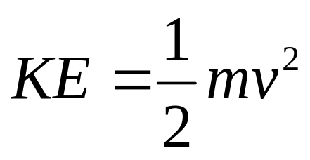
Kinetic Energy
Kinetic Energy is energy associated with the state of motion of an object
For an object moving with a speed of v
SI unit: joule (J)
1 joule = 1 J = 1 kg m²/s²

Slide 6
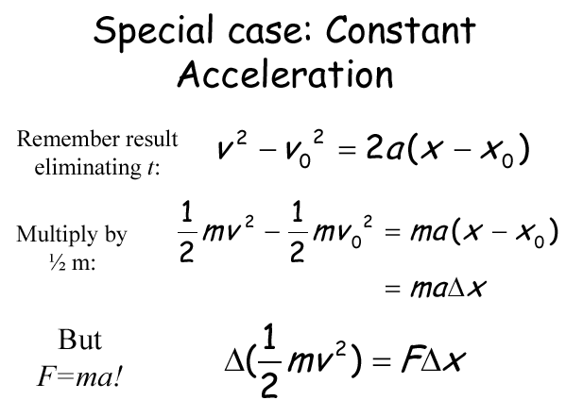
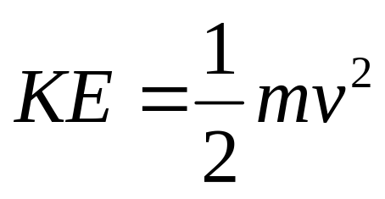
Why ?

Slide 7
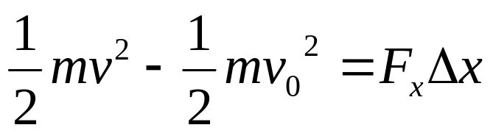
Work W
Start with Work “W”
Work provides a link between force and energy
Work done on an object is transferred to/from it
If W > 0, energy added: “transferred to the object”
If W < 0, energy taken away: “transferred from the object”

Slide 8

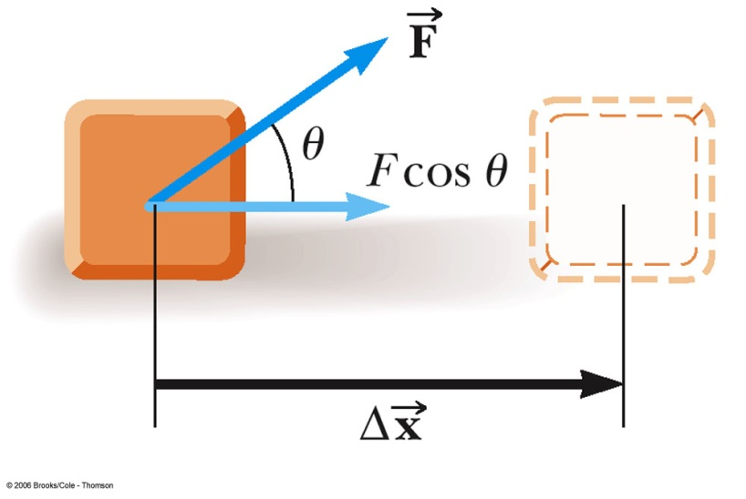

Definition of Work W
The work, W, done by a constant force on an object is defined as the product of the component of the force along the direction of displacement and the magnitude of the displacement
  F is the magnitude of the force
  Δ x is the magnitude of the
  object’s displacement
  θ is the angle between

Slide 9
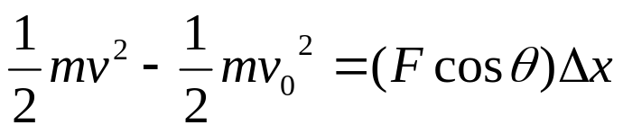
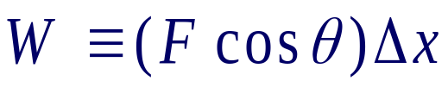
Work Unit
This gives no information about
  the time it took for the displacement to occur
  the velocity or acceleration of the object
Work is a scalar quantity
SI Unit
  Newton • meter = Joule
    N • m = J
    J = kg • m² / s² = ( kg • m / s² ) • m

Slide 10


Work: + or -?
Work can be positive, negative, or zero. The sign of the work depends on the direction of the force relative to the displacement
  Work positive: W > 0 if 90°> θ > 0°
  Work negative: W < 0 if 180°> θ > 90°
  Work zero: W = 0 if θ = 90°
  Work maximum if θ = 0°
  Work minimum if θ = 180°

Slide 11
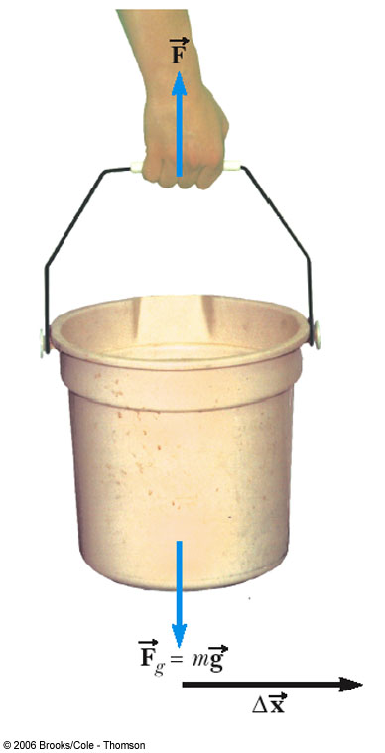

Example: When Work is Zero
A man carries a bucket of water horizontally at constant velocity.
The force does no work on the bucket
Displacement is horizontal
Force is vertical
cos 90° = 0

Slide 12
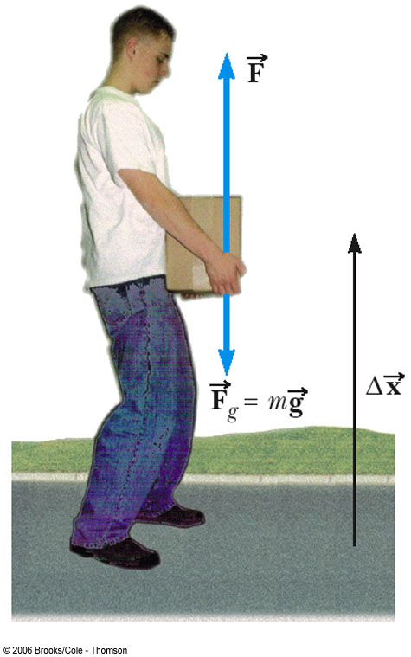
Example: Work Can Be
Positive or Negative
Work is positive when lifting the box
Work would be negative if lowering the box
  The force would still be upward, but the displacement would be downward

Slide 13





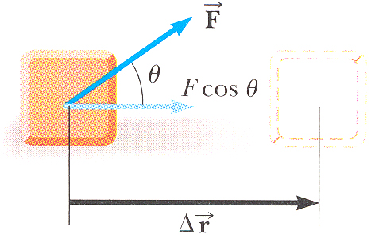


Work Done by a Constant Force
The work W done on a system by an agent exerting a constant force on the system is the product of the magnitude F of the force, the magnitude Δr of the displacement of the point of application of the force, and cosθ, where θ is the angle between the force and displacement vectors:
I
II
III
IV

Slide 14
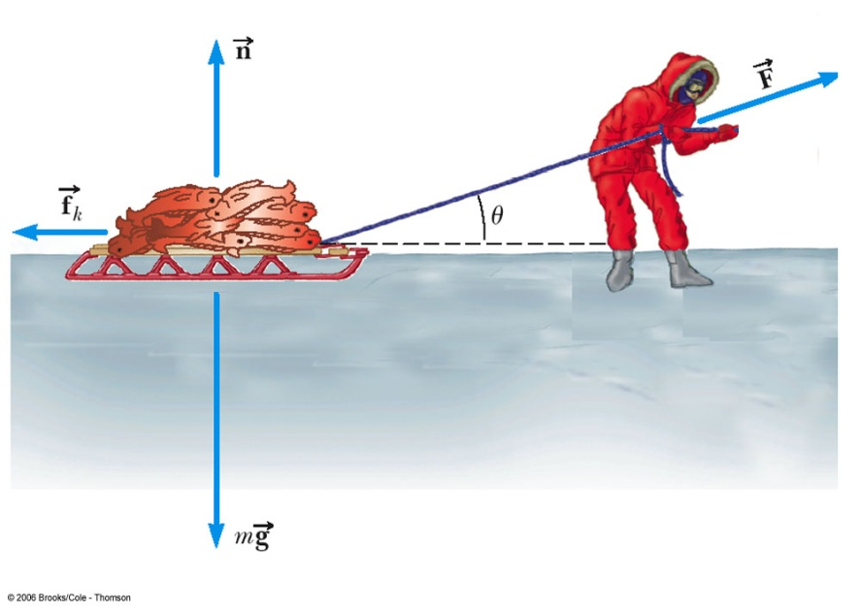
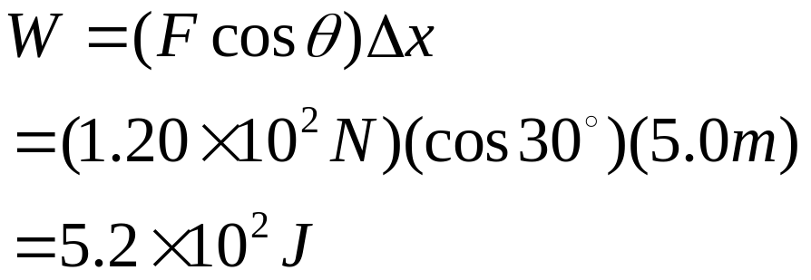
Work and Force
An Eskimo pulls a sled as shown. The total mass of the sled is 50.0 kg, and he exerts a force of 1.20 × 10² N on the sled by pulling on the rope. How much work does he do on the sled if θ = 30°and he pulls the sled 5.0 m ?

Slide 15

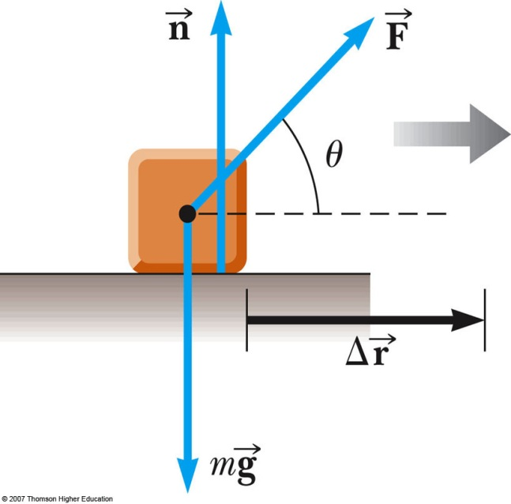
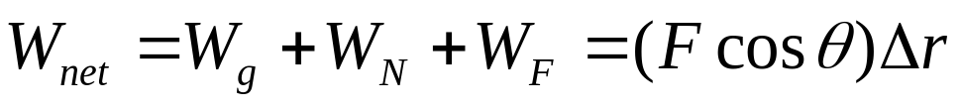
Work Done by Multiple Forces
If more than one force acts on an object, then the total work is equal to the algebraic sum of the work done by the individual forces
  Remember work is a scalar, so
  this is the algebraic sum

Slide 16

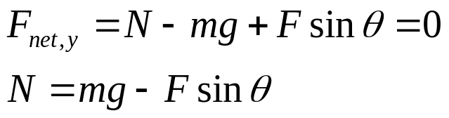
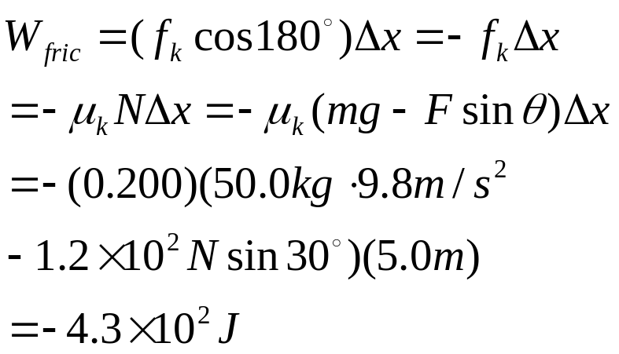
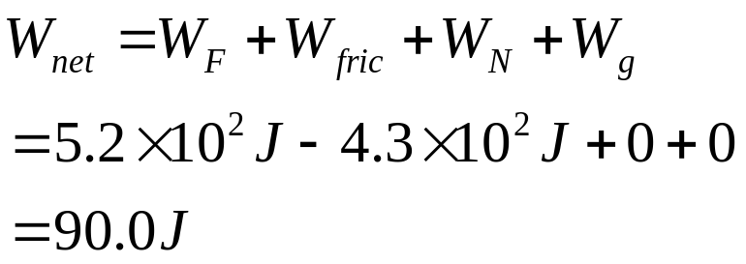
Work and Multiple Forces
Suppose µ_{k} = 0.200, How much work done on the sled by friction, and the net work if θ = 30° and he pulls the sled 5.0 m ?

Slide 17
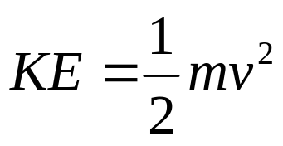
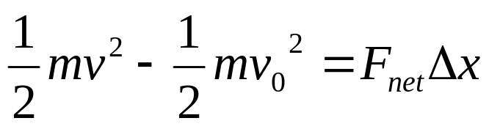

Kinetic Energy
Kinetic energy associated with the motion of an object
Scalar quantity with the same unit as work
Work is related to kinetic energy

Slide 19
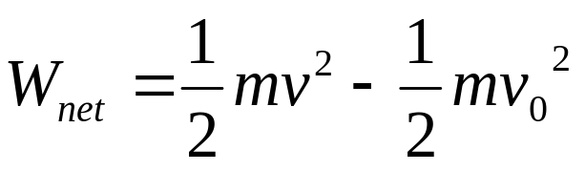
Work-Kinetic Energy Theorem
When work is done by a net force on an object and the only change in the object is its speed, the work done is equal to the change in the object’s kinetic energy
  Speed will increase if work is positive
  Speed will decrease if work is negative

Slide 20
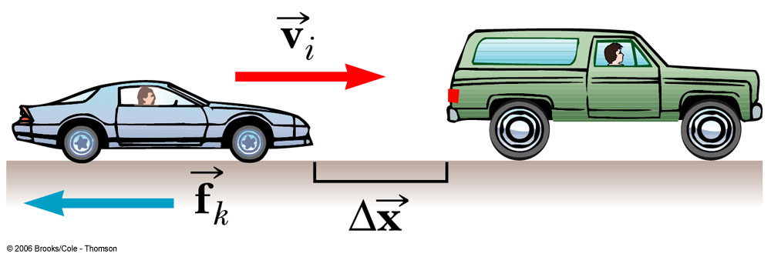
Work and Kinetic Energy
The driver of a 1.0010³ kg car traveling on the interstate at 35.0 m/s slam on his brakes to avoid hitting a second vehicle in front of him, which had come to rest because of congestion ahead. After the breaks are applied, a constant friction force of 8.0010³ N acts on the car. Ignore air resistance. (a) At what minimum distance should the brakes be applied to avoid a collision with the other vehicle? (b) If the distance between the vehicles is initially only 30.0 m, at what speed would the collisions occur?

Slide 21
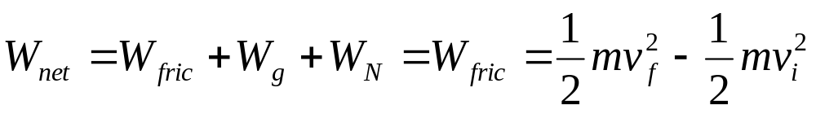
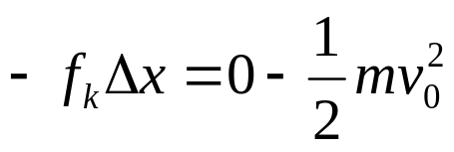
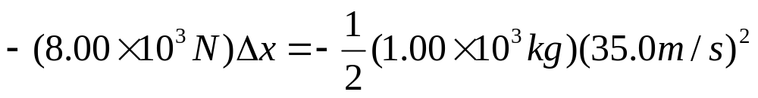

Work and Kinetic Energy
(a) We know
Find the minimum necessary stopping distance

Slide 22
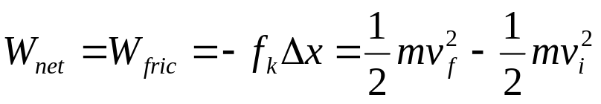
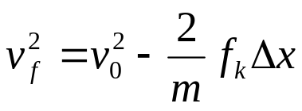
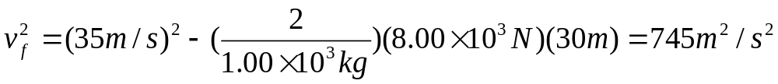
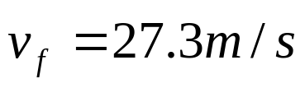
Work and Kinetic Energy
(b) We know
Find the speed at impact.
Write down the work-energy theorem:

Slide 23
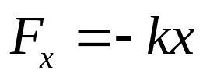
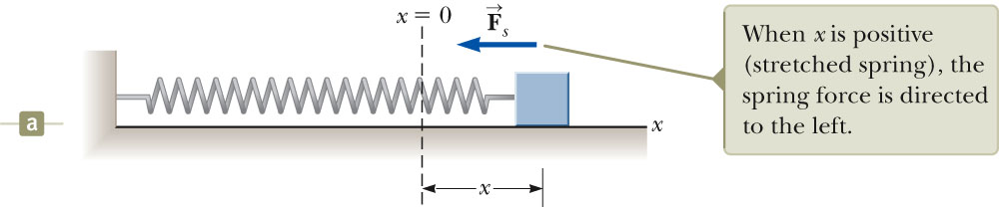
Work Done By a Spring
Spring force

Slide 24
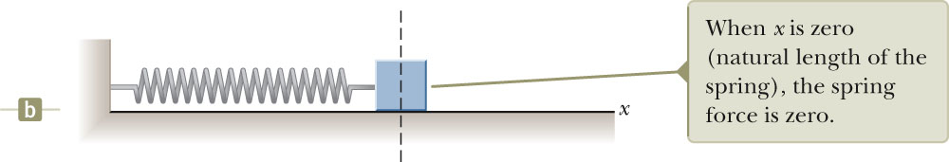
Spring at Equilibrium
F = 0

Slide 25
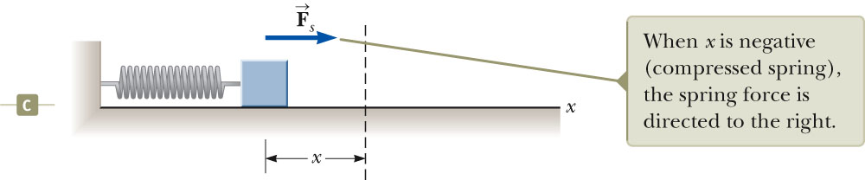
Spring Compressed

Slide 26
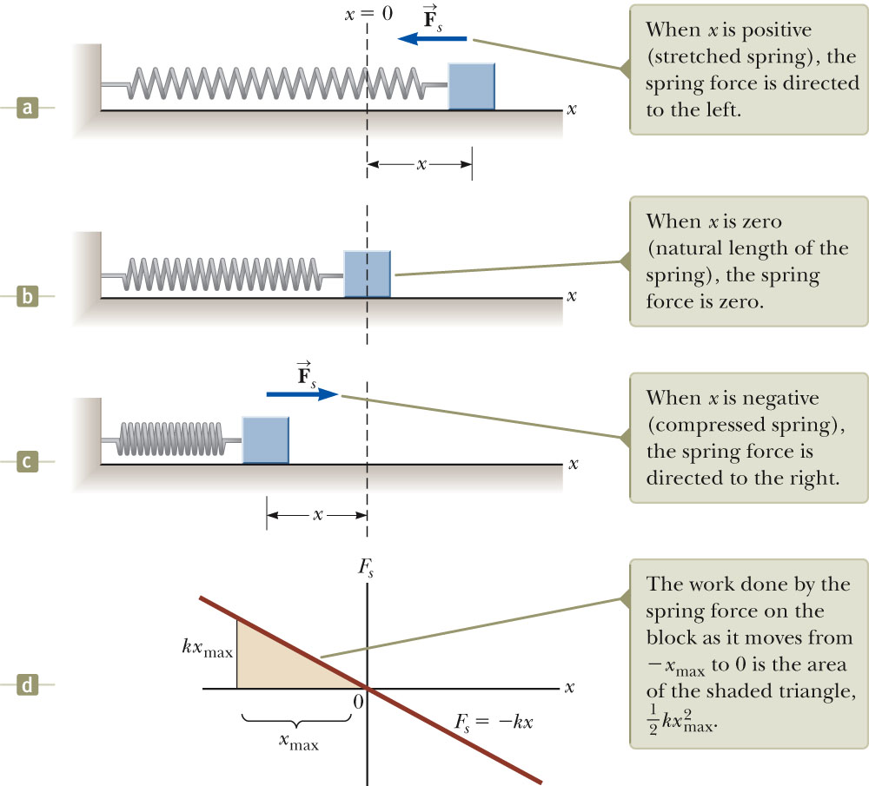
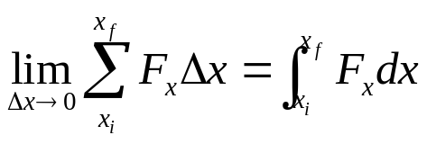
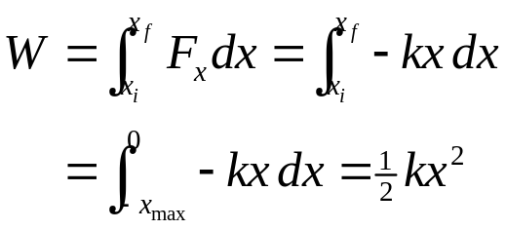
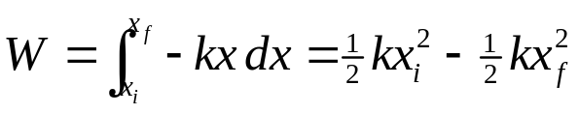
Work done by
spring on block
Fig. 7.9, p. 173
Notes:
The force exerted by a spring on a block varies with the block’s position x relative to the equilibrium position x = 0. (a) x is positive. (b) x is zero. (c) x is negative. (d) Graph of Fs versus x for the block–spring system.

Slide 27
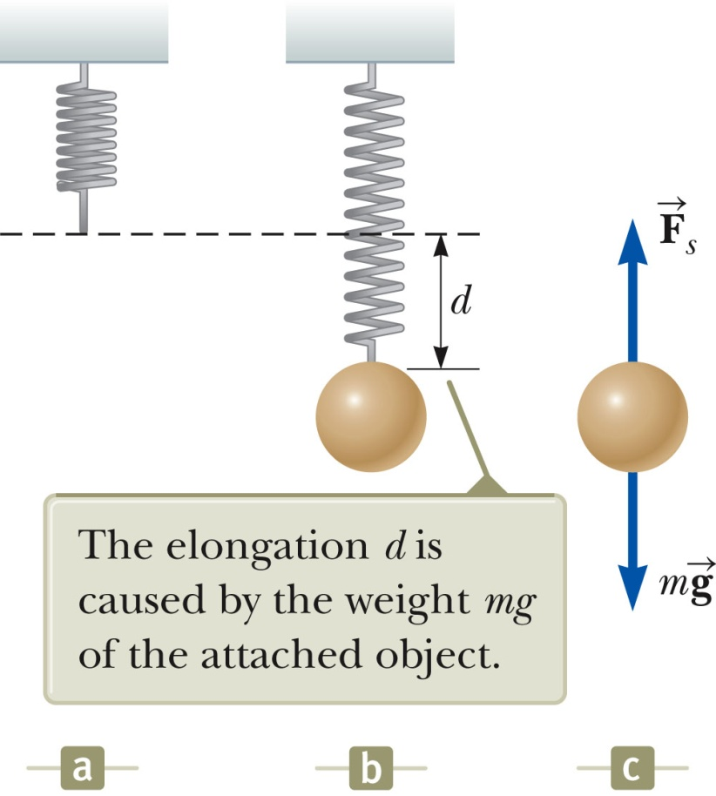
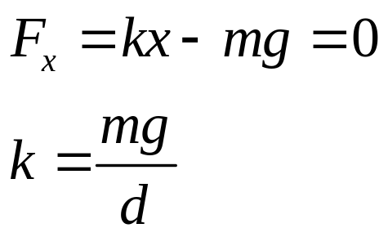
Measuring Spring Constant
Start with spring at its natural equilibrium length.
Hang a mass on spring and let it hang to distance d (stationary)
From
so can get spring constant.

Slide 28
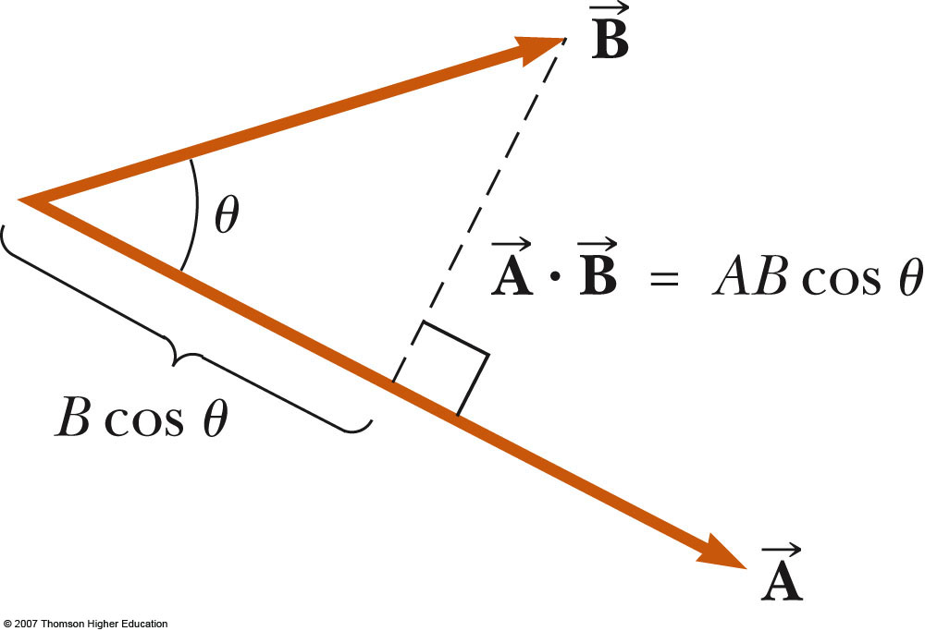

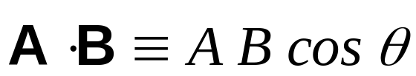
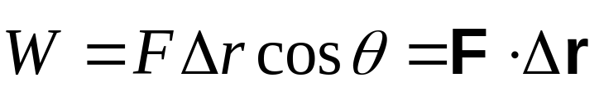
Scalar (Dot) Product of 2 Vectors
The scalar product of two vectors is written as
  It is also called the dot product
  θ is the angle between A and B
Applied to work, this means

Slide 29

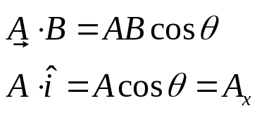




Dot Product
The dot product says something about how parallel two vectors are.
The dot product (scalar product) of two vectors can be thought of as the projection of one onto the direction of the other.
Components
θ

Slide 30
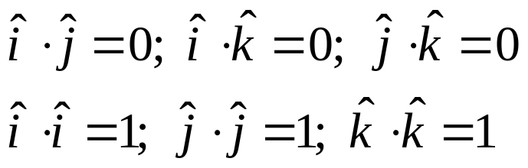
Projection of a Vector: Dot Product
The dot product says something about how parallel two vectors are.
The dot product (scalar product) of two vectors can be thought of as the projection of one onto the direction of the other.
Components
Projection is zero
π/2

Slide 31
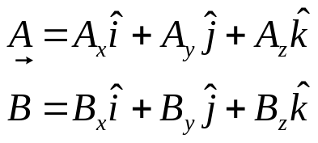
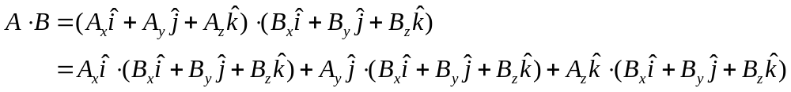
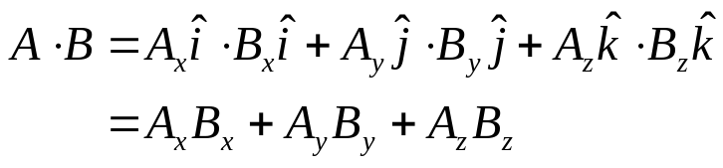
Derivation
How do we show that ?
Start with
Then
But
So

Slide 32
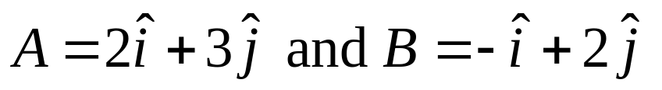
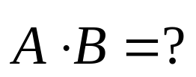
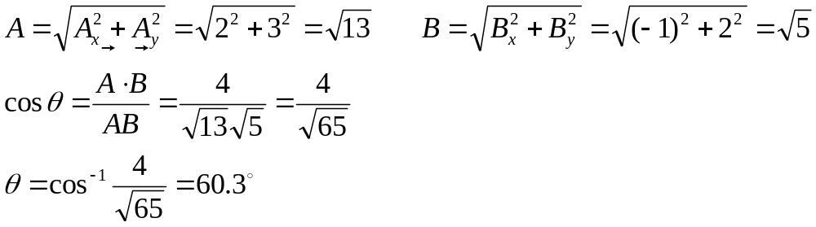
Scalar Product
The vectors
Determine the scalar product
Find the angle θ between these two vectors

